Slide 1

Induction Programme
Department of History
Tarakeswar Degree College
Tarakeswar
Estd. 1986

Slide 2

Department at a Glance

Slide 3
Teachers’
Name | Designation | Abbreviation of Names
Dr. Arundhati Moulik (Ray) | Associate Professor | AR
Dr. Sahidujjaman Khan | Head of the Department & Assistant Professor | SK
Samarpita Ghosh | SACT | SG
Umesh Biswas | SACT | UB
Sukanta Adhikary | SACT | SA
Koustav Bagchi | SACT | KB
Soumen Ghosh | SACT | SMG
Tanmoy Ghosh | SACT | TG
https://www.tarakeswardegreecollege.org/pages/academics/faculty.php

Slide 4
Choice Based Credit System (CBCS)
Introduction
Applicability of the Grading System
Definitions of Key Words:
Semester System and Choice Based Credit System
Types of Courses
Examination and Assessment
Computation of SGPA and CGPA
Illustration of Computation of SGPA and CGPA and Format for Transcripts
Related resources

Slide 5
Introduction
The University Grants Commission (UGC) has initiated several measures to bring equity, efficiency and excellence in the Higher Education System of country. The important measures taken to enhance academic standards and quality in higher education include innovation and improvements in curriculum, teaching-learning process, examination and evaluation systems, besides governance and other matters.

Slide 6
Introduction
The UGC has formulated various regulations and guidelines from time to time to improve the higher education system and maintain minimum standards and quality across the Higher Educational Institutions (HEIs) in India. The academic reforms recommended by the UGC in the recent past have led to overall improvement in the higher education system. However, due to lot of diversity in the system of higher education, there are multiple approaches followed by universities towards examination, evaluation and grading system. While the HEIs must have the flexibility and freedom in designing the examination and evaluation methods that best fits the the curriculum, syllabi and teaching–learning methods, there is a need to devise a sensible system for awarding the grades based on the performance of students. Presently the performance of the students is reported using the conventional system of marks secured in the examinations or grades or both. The conversion from marks to letter grades and the letter grades used vary widely across the HEIs in the country. This creates difficulty for the academia and the employers to understand and infer the performance of the students graduating from different universities and colleges based on grades.

Slide 7
Introduction
The grading system is considered to be better than the conventional marks system and hence it has been followed in the top institutions in India and abroad. So it is desirable to introduce uniform grading system. This will facilitate student mobility across institutions within and across countries and also enable potential employers to assess the performance of students. To bring in the desired uniformity, in grading system and method for computing the cumulative grade point average (CGPA) based on the performance of students in the examinations, the UGC has formulated these guidelines.

Slide 8
Grading System
These guidelines shall apply to all undergraduate and postgraduate level degree, diploma and certificate programmes under the credit system awarded by the Central, State and Deemed to be universities in India.

Slide 9
Definitions of Key Words:
Academic Year: Two consecutive (one odd + one even) semesters constitute one academic year.
Choice Based Credit System (CBCS): The CBCS provides choice for students to select from the prescribed courses (core, elective or minor or soft skill courses).
Course: Usually referred to, as ‘papers’ is a component of a programme. All courses need not carry the same weight. The courses should define learning objectives and learning outcomes. A course may be designed to comprise lectures/ tutorials/laboratory work/ field work/ outreach activities/ project work/ vocational training/viva/ seminars/ term papers/assignments/ presentations/ self-study etc. or a combination of some of these.

Slide 10
Credit Based Semester System (CBSS): Under the CBSS, the requirement for awarding a degree or diploma or certificate is prescribed in terms of number of credits to be completed by the students.

Slide 11
Credit Point
It is the product of grade point and number of credits for a course.

Slide 12
Credit
A unit by which the course work is measured. It determines the number of hours of instructions required per week. One credit is equivalent to one hour of teaching (lecture or tutorial) or two hours of practical work/field work per week.

Slide 13
Cumulative Grade Point Average (CGPA)
It is a measure of overall cumulative performance of a student over all semesters. The CGPA is the ratio of total credit points secured by a student in various courses in all semesters and the sum of the total credits of all courses in all the semesters. It is expressed up to two decimal places.
Grade Point: It is a numerical weight allotted to each letter grade on a 10-point scale.
Letter Grade: It is an index of the performance of students in a said course. Grades are denoted by letters O, A+, A, B+, B, C, P and F.
Programme: An educational programme leading to award of a Degree, diploma or certificate.

Slide 14
Semester Grade Point Average (SGPA)
It is a measure of performance of work done in a semester. It is ratio of total credit points secured by a student in various courses registered in a semester and the total course credits taken during that semester. It shall be expressed up to two decimal places.

Slide 15
Semester:
Each semester will consist of 15-18 weeks of academic work equivalent to 90 actual teaching days. The odd semester may be scheduled from July to December and even semester from January to June.

Slide 16
Transcript or Grade Card or Certificate
Based on the grades earned, a grade certificate shall be issued to all the registered students after every semester. The grade certificate will display the course details (code, title, number of credits, grade secured) along with SGPA of that semester and CGPA earned till that semester.

Slide 17
Semester System and Choice Based Credit System
The Indian Higher Education Institutions have been moving from the conventional annual system to semester system. Currently many of the institutions have already introduced the choice based credit system. The semester system accelerates the teaching-learning process and enables vertical and horizontal mobility in learning. The credit based semester system provides flexibility in designing curriculum and assigning credits based on the course content and hours of teaching. The choice based credit system provides a ‘cafeteria’ type approach in which the students can take courses of their choice, learn at their own pace, undergo additional courses and acquire more than the required credits, and adopt an interdisciplinary approach to learning, It is desirable that the HEIs move to CBCS and implement the grading system.

Slide 18
Types of Courses
CORE COURSES
FOUNDATION COURSES
ELECTIVE COURCES

Slide 19
Core Course (I-XIV)
There may be a Core Course in every semester. This is the course which is to be compulsorily studied by a student as a core requirement to complete the requirement of a programme in a said discipline of study.

Slide 20
Elective Course
Elective course is a course which can be chosen from a pool of papers.
It may be:
Supportive to the discipline of study
Providing an expanded scope
Enabling an exposure to some other discipline/domain
Nurturing student’s proficiency/skill.

Slide 21
Foundation Course
The Foundation Courses may be of two kinds:
Compulsory Foundation and Elective foundation
Compulsory Foundation courses are the courses based upon the content that leads to Knowledge enhancement. They are mandatory for all disciplines.
Elective Foundation courses are value-based and are aimed at man-making education.

Slide 22
Examination and Assessment
The HEIs are currently following various methods for examination and assessment suitable for the courses and programmes as approved by their respective statutory bodies. In assessing the performance of the students in examinations, the usual approach is to award marks based on the examinations conducted at various stages (sessional, mid-term, end-semester etc.,) in a semester. Some of the HEIs convert these marks to letter grades based on absolute or relative grading system and award the grades. There is a marked variation across the colleges and universities in the number of grades, grade points, letter grades used, which creates difficulties in comparing students across the institutions. The UGC recommends the following system to be implemented in awarding the grades and CGPA under the credit based semester system.

Slide 23
Letter Grades and Grade Points
Two methods -relative grading or absolute grading– have been in vogue for awarding grades in a course. The relative grading is based on the distribution (usually normal distribution) of marks obtained by all the students of the course and the grades are awarded based on a cut-off marks or percentile. Under the absolute grading, the marks are converted to grades based on pre-determined class intervals. To implement the following grading system, the colleges and universities can use any one of the above methods.

Slide 24
The UGC recommends a 10-point grading system with the following letter grades as given below:
Letter Grade | Letter Grade
O (Outstanding) | 10
A+(Excellent) | 9
A(Very Good) | 8
B+(Good) | 7
B(Above Average) | 6
C(Average) | 5
P (Pass) | 4
F(Fail) | 0
Ab (Absent) | 0

Slide 25
Grades and Grade Points
A student obtaining Grade F shall be considered failed and will be required to reappear in the examination.
For non credit courses ‘Satisfactory’ or “Unsatisfactory’ shall be indicated instead of the letter grade and this will not be counted for the computation of SGPA/CGPA.
The Universities can decide on the grade or percentage of marks required to pass in a course and also the CGPA required to qualify for a degree taking into consideration the recommendations of the statutory professional councils such as AICTE, MCI, BCI, NCTE etc.,
The statutory requirement for eligibility to enter as assistant professor in colleges and universities in the disciplines of arts, science, commerce etc., is a minimum average mark of 50% and 55% in relevant postgraduate degree respectively for reserved and general category. Hence, it is recommended that the cut-off marks for grade B shall not be less than 50% and for grade B+, it should not be less than 55% under the absolute grading system. Similarly cut-off marks shall be fixed for grade B and B+ based on the recommendation of the statutory bodies (AICTE, NCTE etc.,) of the relevant disciplines.

Slide 26
Fairness in Assessment
Assessment is an integral part of system of education as it is instrumental in identifying and certifying the academic standards accomplished by a student and projecting them far and wide as an objective and impartial indicator of a student’s performance. Thus, it becomes bounden duty of a University to ensure that it is carried out in fair manner. In this regard, UGC recommends the following system of checks and balances which would enable Universities effectively and fairly carry out the process of assessment and examination.

Slide 27
Fairness in Assessment
In case of at least 50% of core courses offered in different programmes across the disciplines, the assessment of the theoretical component towards the end of the semester should be undertaken by external examiners from outside the university conducting examination, who may be appointed by the competent authority. In such courses, the question papers will be set as well as assessed by external examiners.
In case of the assessment of practical component of such core courses, the team of examiners should be constituted on 50 – 50 % basis. i.e. half of the examiners in the team should be invited from outside the university conducting examination.
In case of the assessment of project reports / thesis / dissertation etc. the work should be undertaken by internal as well as external examiners.

Slide 28
Computation of SGPA and CGPA
The UGC recommends the following procedure to compute the Semester Grade Point Average (SGPA) and Cumulative Grade Point Average (CGPA):
The SGPA is the ratio of sum of the product of the number of credits with the grade points scored by a student in all the courses taken by a student and the sum of the number of credits of all the courses undergone by a student, i.e

Slide 29
SGPA (Si) = Σ(Ci x Gi) / ΣCi
where Ci is the number of credits of the course and Gi is the grade point scored by the student in the ith course.
The CGPA is also calculated in the same manner taking into account all the courses undergone by a student over all the semesters of a programme,

Slide 30
CGPA = Σ(Ci x Si) / Σ Ci
where Si is the SGPA of the each semester and Ci is the total number of credits in that semester.
The SGPA and CGPA shall be rounded off to 2 decimal points and reported in the transcripts.

Slide 31
Illustration of Computation of SGPA and CGPA and Format for Transcripts
Computation of SGPA and CGPA
Illustration for SGPA

Slide 32
Computation of SGPA and CGPA
Course | Credit | Grade letter | Grade point | Credit Point(Credit x Grade)
Course 1 | 3 | A | 8 | 3x8=24
Course 2 | 4 | B+ | 7 | 7x4=28
Course 3 | 3 | B | 6 | 3x8=18
Course 4 | 3 | O | 10 | 3x10=30
Course 5 | 3 | C | 5 | 3x5=15
Course 6 | 4 | B | 4 | 4x4=16
 | 20 |  |  | 130
Thus, SGPA =139/20 =6.95

Slide 33
Illustration for CGPA
Semester 1 | Semester 2 | Semester 3 | Semester 4 | Semester 5 | Semester 6
Credit : 20 SGPA:6.9 | Credit : 22 SGPA:7.8 | Credit : 25 SGPA: 5.6 | Credit : 26 SGPA:6.0 | Credit : 26 SGPA:6.3 | Credit : 25 SGPA: 8.0
Thus, CGPA = 20 x 6.9 + 22 x 7.8 + 25 x 5.6 + 26 x 6.0 + 26 x 6.3 + 25 x 8.0/ 144 = 6.73
Transcript (Format): Based on the above recommendations on Letter grades, grade points and SGPA and CCPA, the HEIs may issue the transcript for each semester and a consolidated transcript indicating the performance in all semesters.

Slide 34
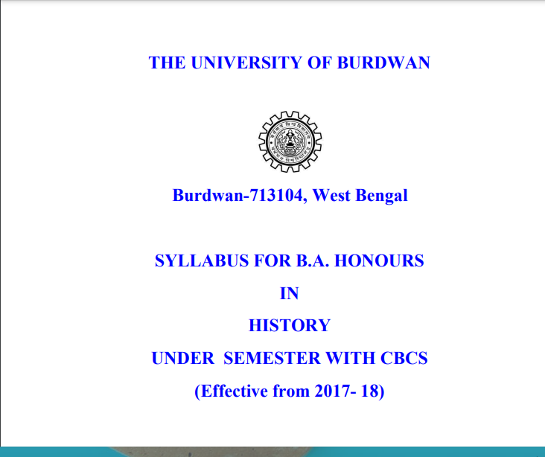
B.A. HONOURS SYLLABUS

Slide 35
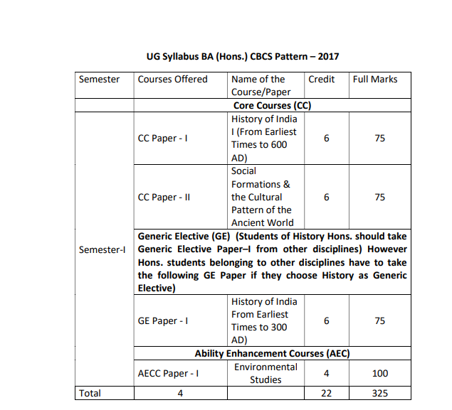
B.A. HONOURS SYLLABUS

Slide 36
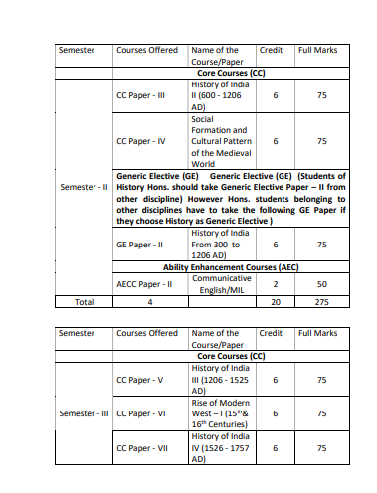

Slide 37
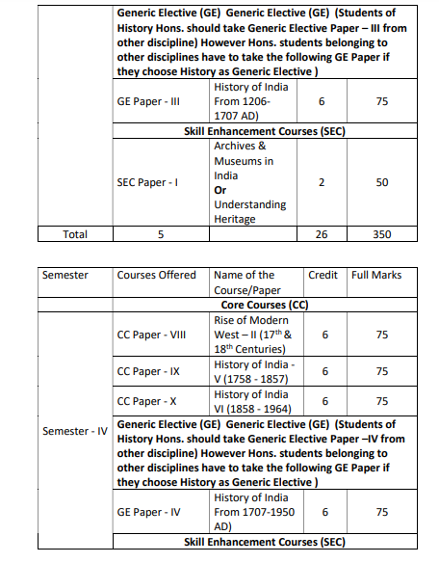

Slide 38
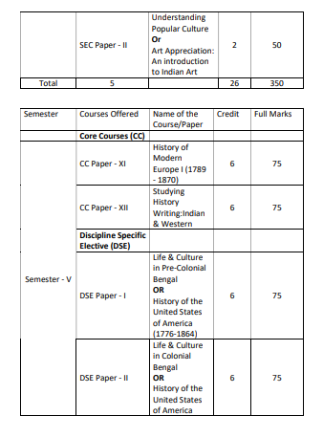

Slide 39
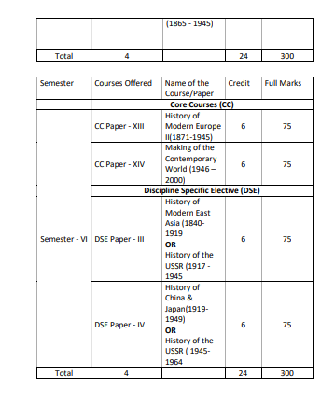

Slide 40

Department of History
1st Semester Students

Slide 41
THANK YOU
Prepared by
Dr. Sahidujjaman Khan
Head of the Department

